Slide 1


Team 5:
Chris Andrade
Chase Champagne
Stacey West Dayzie
Nicole Faris
Saketh Reddy
UrbaGro

Slide 2
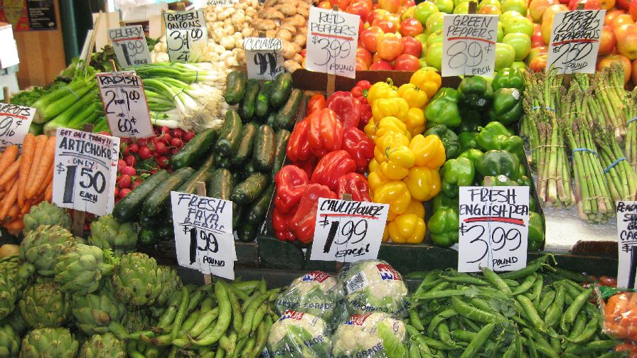

PROBLEM
RISING COSTS
LACK OF KNOWLEDGE
Costs for grocery store produce are rising, make it more expensive than ever to buy healthy fruits and vegetables
Many customers lack the knowledge of large scale agriculture, and also lack the space required to to grow their own produce in their homes/yards
CLIMATE CHANGE
OBESITY
Climate change is decimating crop output around the country and world, making produce more difficult to get
The obesity rate is increasing in many countries, especially here in the US. A lack of access to healthy foods is a driver of this increasing obesity rate

Slide 3
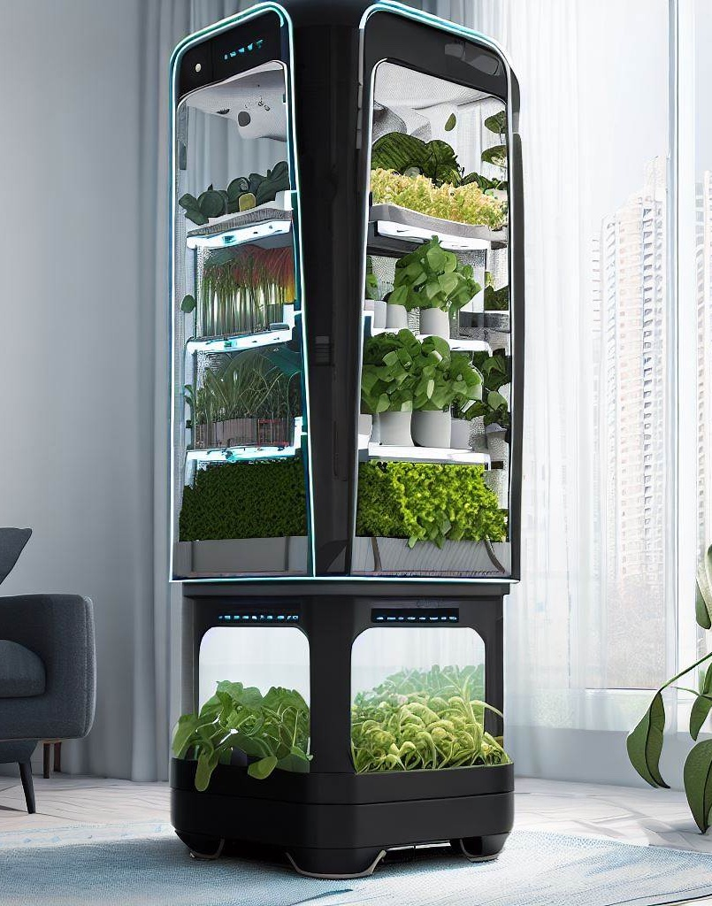
SOLUTION
CLOSE THE GAP
TARGET AUDIENCE
Our product makes organic farming at home easier, and no other product on the market offers the same benefits or yield
23–40-year-old males and females who enjoy helping the environment and saving money
COST SAVINGS
EASY TO USE
Customers will notice significant savings by growing their own produce, rather than buying from supermarkets
A simple product that gives customers the information they need in order to grow abundant amounts of fresh produce

Slide 4

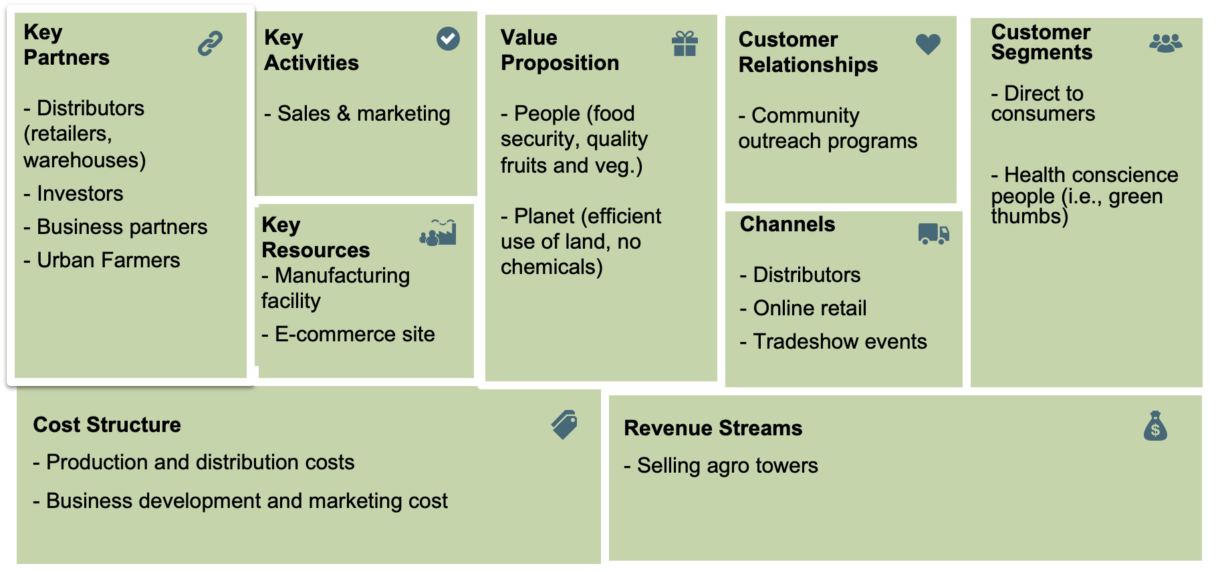
Business Model

Slide 5
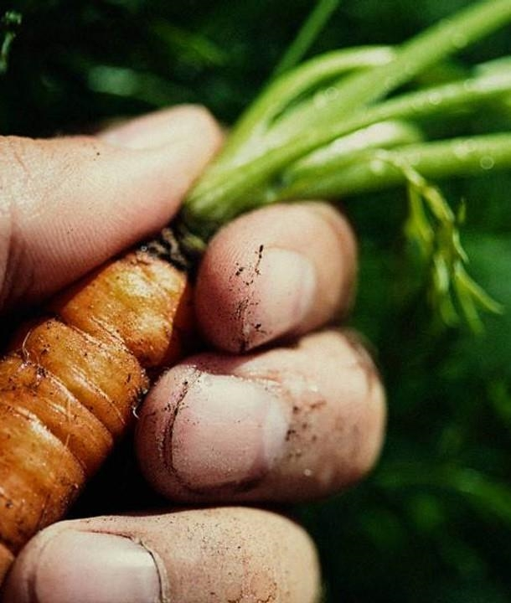
MARKET OVERVIEW
Total Addressable Market​
“...70% of American households participate in some form of gardening.”
90.3 million
Serviceable Available Market​
Based on target consumer personas and market research
20.9 million
Serviceable Obtainable Market​
Achieve 1% market share driven by quality and affordability
209K households

Slide 6






SALES & MARKETING
PLACE
PRICE
PROMOTION
PRODUCT
UrbaGro Ultra Smart Indoor Tower
$150/unit
$30/month subscription

Slide 7
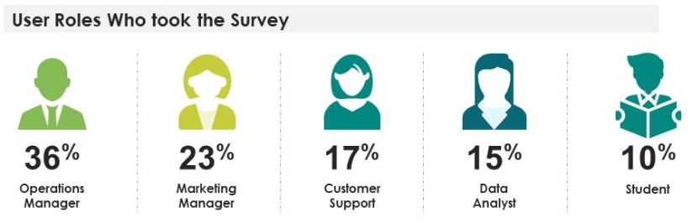

PRIMARY RESEARCH
43.5%
56.6%
Total Survey Respondents
85
Target Market Group Age Range:
23 - 40

Slide 8
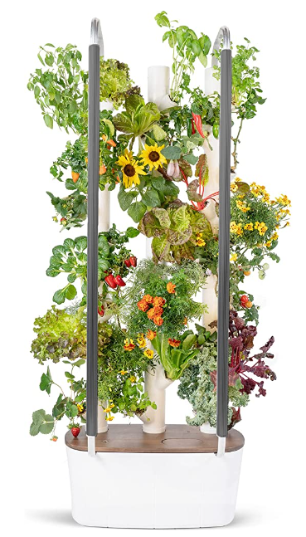


PRIMARY RESEARCH CONT.
Product Price Points:
Ultimate Business Factors:
Smaller
Size
$150 or less
Ease of Use and Maintenance
Gardening / Recipe Education
Learning Resources to Support Local Community
43.5%
Competitor’s Unit Cost:
$596
Agro Tower Unit Cost:
$150
Monthly Subscription Cost:
$30
Average Household Income:
$ 47,356
Average Percent of Income on Groceries:
10.3%

Slide 9











Competition
UrbaGro
Gardyn
Rise Gardens
AeroGarden
Price
$150/unit
$600-$1000
$750
$70-$200
$699
$20-$50
Ease of Use
Beginner
Beginner
Novice
Beginner
Beginner
Expert
Plant Capacity
10-15 Plants
30 plants
36+
3 plants
36
1-10
Smart
*Data from Gardyn, Rise Gardens, AeroGarden, & Lettuce Grow websites

Slide 10
COMPETITIVE LAYOUT
CONVENIENT
$1000
$700
$500
$300
$200
$150
$100
$50
EXPENSIVE​
AFFORDABLE
D.I.Y.
INCONVENIENT​

Slide 11

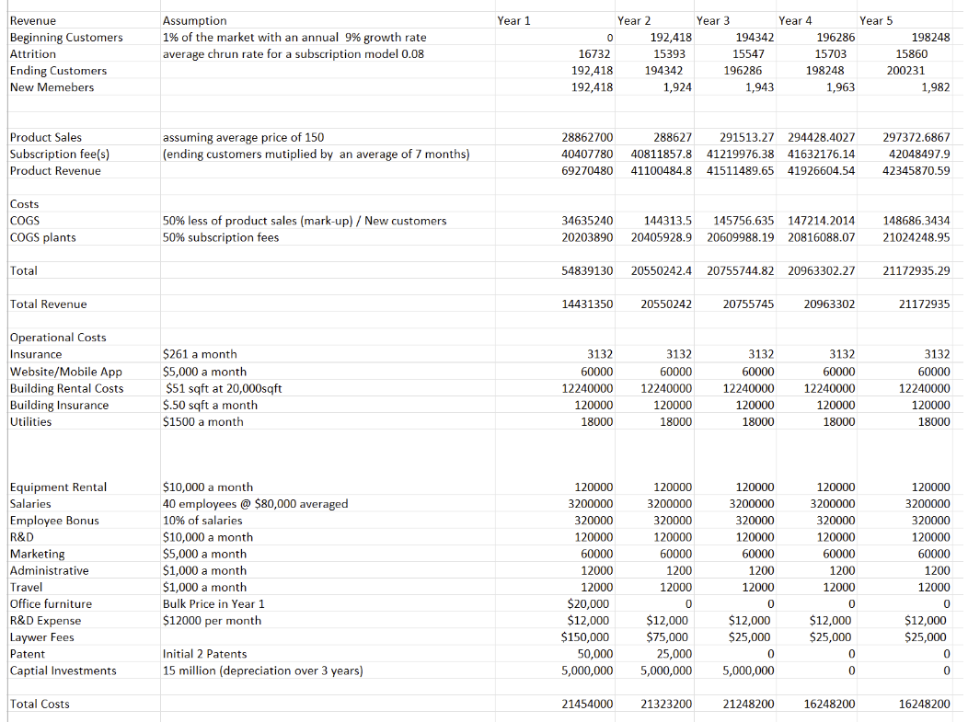
Financials
1% of the market | Year 1 | Year 2 | Year 3 | Year 4 | Year 5
Net Revenue | (7,022,650) | (772,958) | (492,455) | 4,715,102 | 4,924,735

Slide 12
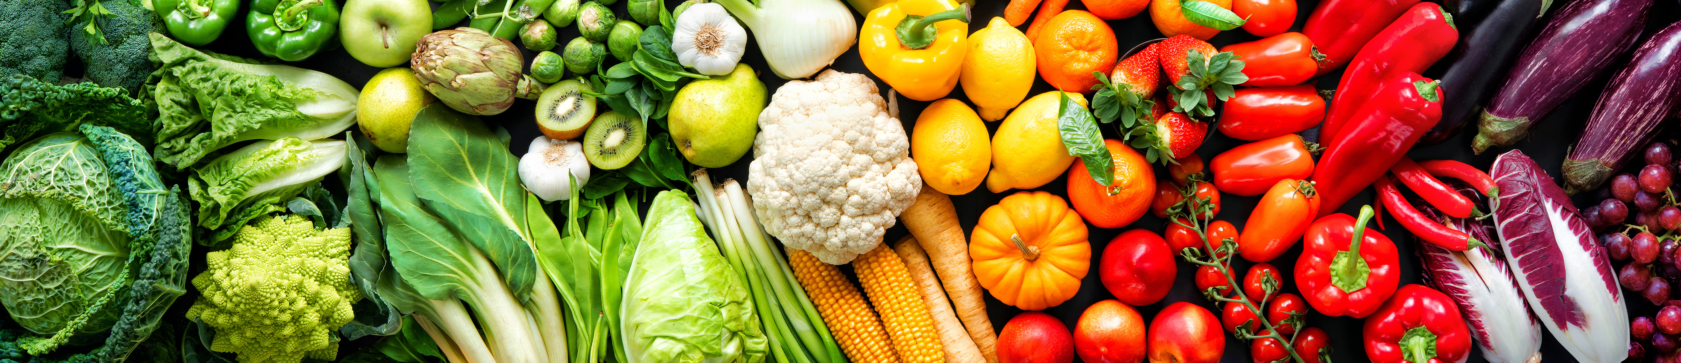
Conclusion
Our mission at UrbaGro is to deliver sustainable, nutritious food that
saves consumers money, fights climate change and obesity,
and enhances public awareness of agricultural practices.

