Slide 1


Slide 2
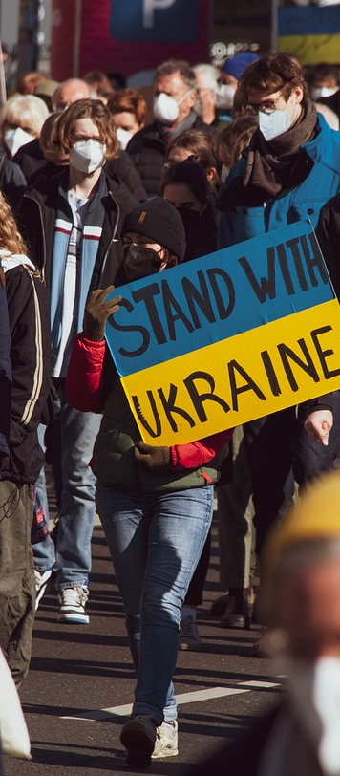
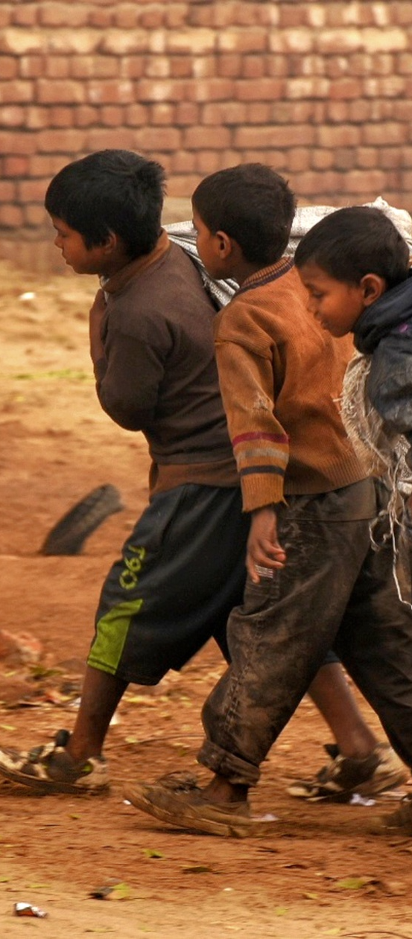


49%
605
114
375
Increase
Million
Million
Million
Violence up since 2008
People living in extreme poverty
Jobs lost due to COVID-19
Obsolete Jobs due to AI/AUTOMATION

Slide 3


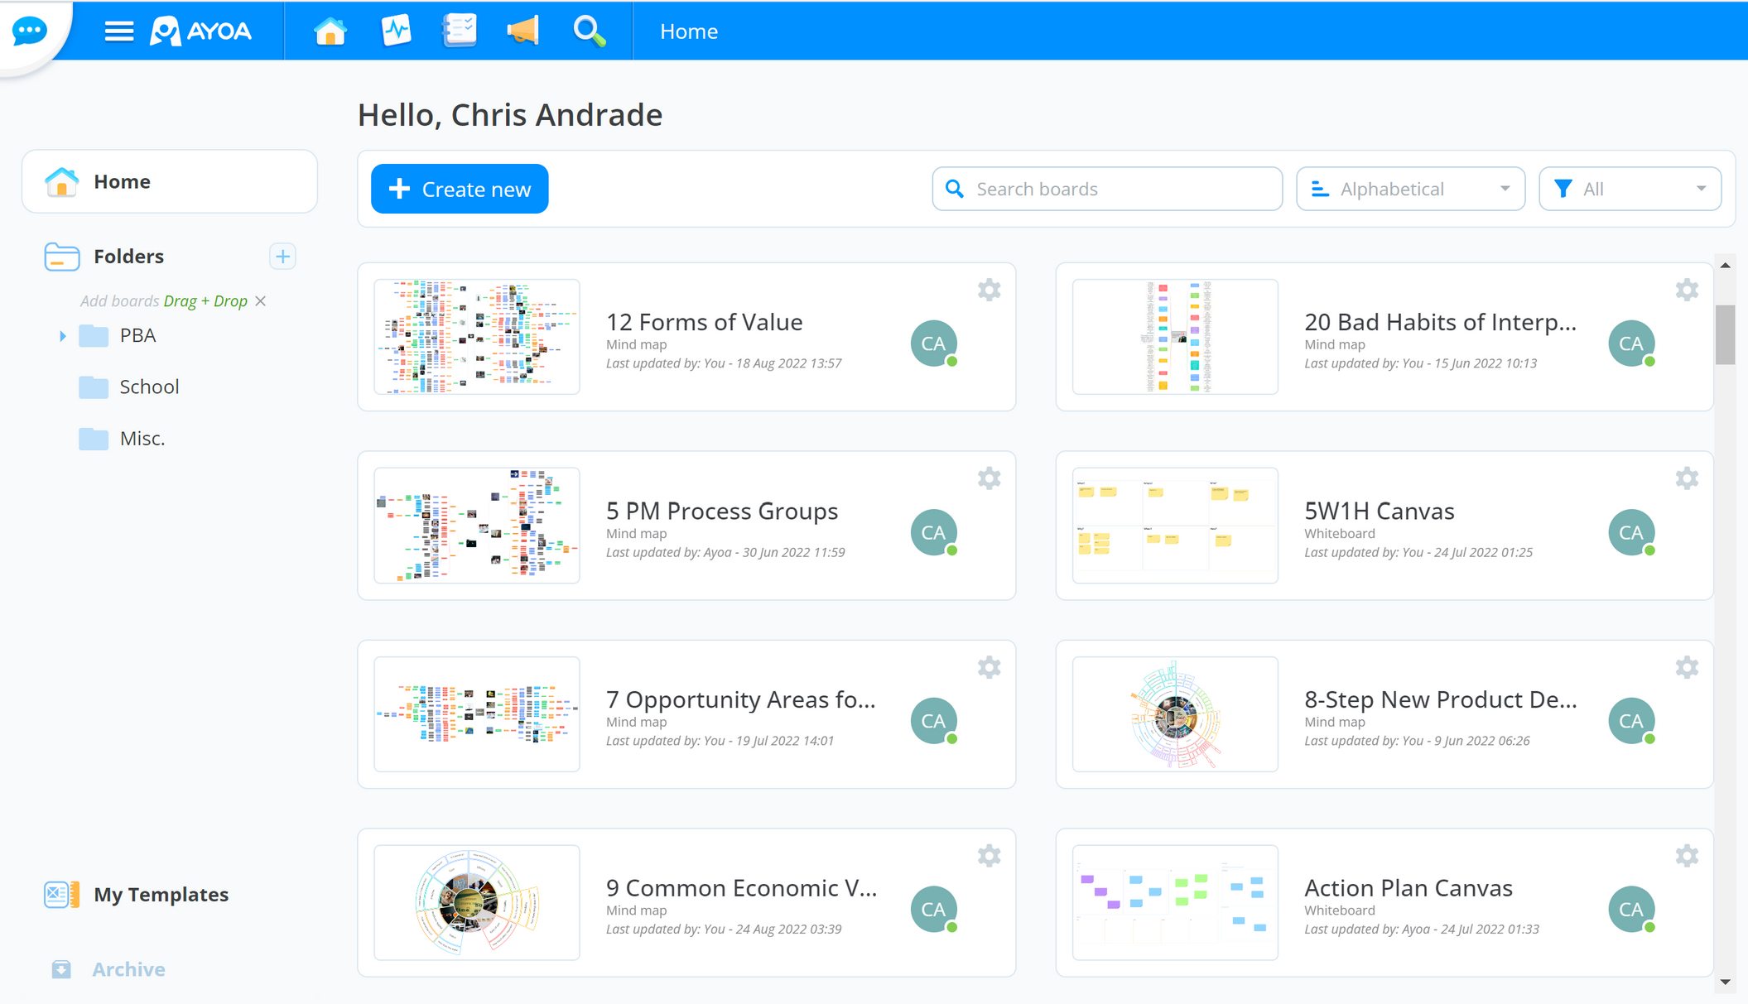

The Peacebuilder Academy
Impact Incubator for All
Zero Barriers to Entry
Effective Learning Style
DIY/DWY/DFY
On-Demand Learning
Idea to Impact & Income
Training
  Social Entrepreneurship
  Conflict Resolution
  Mindfulness & Self-Mastery
Notes:
Learning Style: Inclusive, engaging, effectiveSocial Entrepreneurship: Idea-> Impact-> IncomeConflict Resolution: Integrative NegotiationsSelf-mastery & Meditation: Inner Peace

Slide 4



Revenue Model
>250 users, projected revenue is $120,000
Churn Rate of 10% and LTV of $600
65% Revenues from Recurring Subscription
20% Total Revenues from Meditation and Motivation Programs
15% Revenue from College and University Programs
Notes:
Revenue Model of Grassroot Peacebuilders is based on hybrid freemium and subscription based model. Our Primary Revenue stream will be from recurring monthly subscriptions Rom aspiring entrepreneurs, career transitioners and retirees. We expect the revenue of $600 per subscriber and $120K revenue per year.

Slide 5
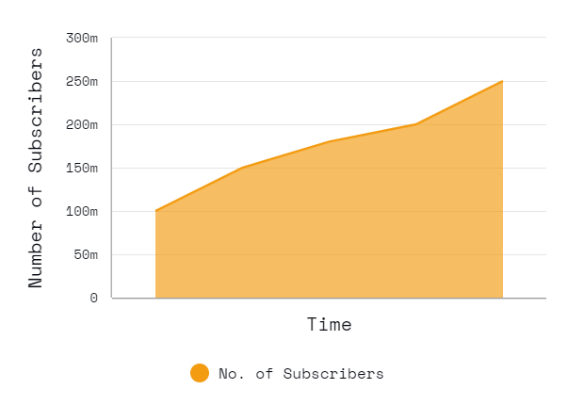
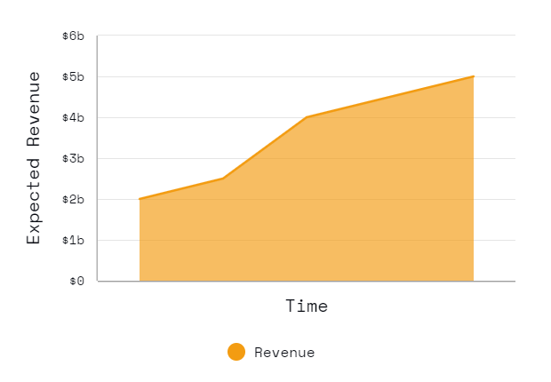
Total Addressable Market (TAM)
Grassroot Peacebuilders expect the TAM of $2B to $5B
Notes:
Changes:
(Add) Updated numbers
(Add) SOM- Service Obtainable Market
(Change) Graphics

Slide 6

















































Our Secret Sauce
Notes:
Promote Social Entrepreneurship using UN's 17 sustainable Develop Goals (SDG)Peacebuilder Academy Online Accelerator Program - Unlimited access to Coaching, training, mentoring, Project Management and Social Education, Conflict Resolution ProgramsBuilding a resilient and compassionate Individual- Meditation and Motivational programs to assist entrepreneurs in achieving inner piece

Slide 7









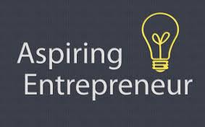


Sales and Marketing
Notes:
Updates:
(Add) rotary International (per chip feedback)= 1.5 million users worldwide
(Add) Zebras United network= exit to community

Slide 8





Competition
Grassroot Peacebuilders
Udemy
Coursera
Skillshare
Net Impact
Peace First
Price
Freemium & $47/month
$15-200/course
$40-100/month
$40-100/month
$25/year for students, $110/year for professionals
$0
Customer
Anyone
Anyone
Anyone
Anyone
Students & professionals
Individuals & organizations
Courses
Social Entrepreneurship
Variety of topics
Variety of topics
Creative & business topics
Social impact topics & skills
Peacebuilding & social justice
Certification
*Data from Udemy, Coursera, Skillshare, Net Impact, and Peace First websites

Slide 9


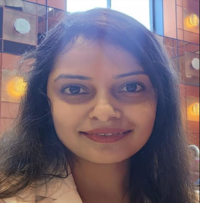



The Team
Shweta Deshpande
Christopher Andrade
Quyên Vuong
Chief Operating Officer
Chief Financial Officer
Founder and CEO
Jake McGraw
Daniel Zellis
Chief Marketing Officer
Chief Technology Officer

Slide 10


Financial Summary
2022
2023
2024
2025
2026
2027
Annual Users
0
180
1200
3600
6000
8400
Revenue (GAAP)
$0
$9k
$60k
$180k
$300k
$420k
Gross Margin
0%
77%
96.6%
98.9%
99.3%
99.5%
EBITDA
($14.8k)
($45.8k)
($3.2k)
$121.6k
$236.8k
$352k

Slide 11













Milestone Roadmap
April 2023
March 2024
JHU Ent Fin Pitch Competition
Initial Product Launch
June 2021
September 2023
Grassroot Peacebuilders founded as NPO
Alpha Testing & Market Surveys
August 2023
December 2023
Finish MVP
August 2022
Beta Testing & Marketing Campaign
Social Business Pivot

Slide 12



Use of Funds
Targeting $500K of Series A funding by December 2023
$300K - Launch MVP & Build Brand awareness
$150K - Strategic talent expansion
$50K - Seeding the Impact Fund
Notes:
Updates:
(Change) Ask→ $50-$150k max for PB sector
1-2x return
(Add) Boostrapping progress

Slide 13
Questions?

