Slide 1
Country Ambassador Redesign
Decision Brief

Slide 2
Agenda
What is a Decision Brief?
Decision Point #1: Recruitment Frequency
Decision Point #2: Management Structure (Organizational Chart)
- Level 2 Ambassadors
Decision Point #3: Size of the Country Ambassador (CA) Program
Decision Point #4: CA Roles and Responsibilities
Decision Point #5: Evaluations/Performance Reviews
Decision Point #6: Acknowledgments & Rewards
Decision Point #7: Knowledge Management
          - Continuity Folder
- Continuous Improvement Thru Lessons Learned
Discussion: Program Priorities?
Timeline Review: Onboarding and Next Steps
Closing Remarks
Notes:
For ‘Solution Tree’ option in ‘Talking to Others’ module.
Image description: The Peace First ‘Solution Tree’ worksheet.

Slide 3
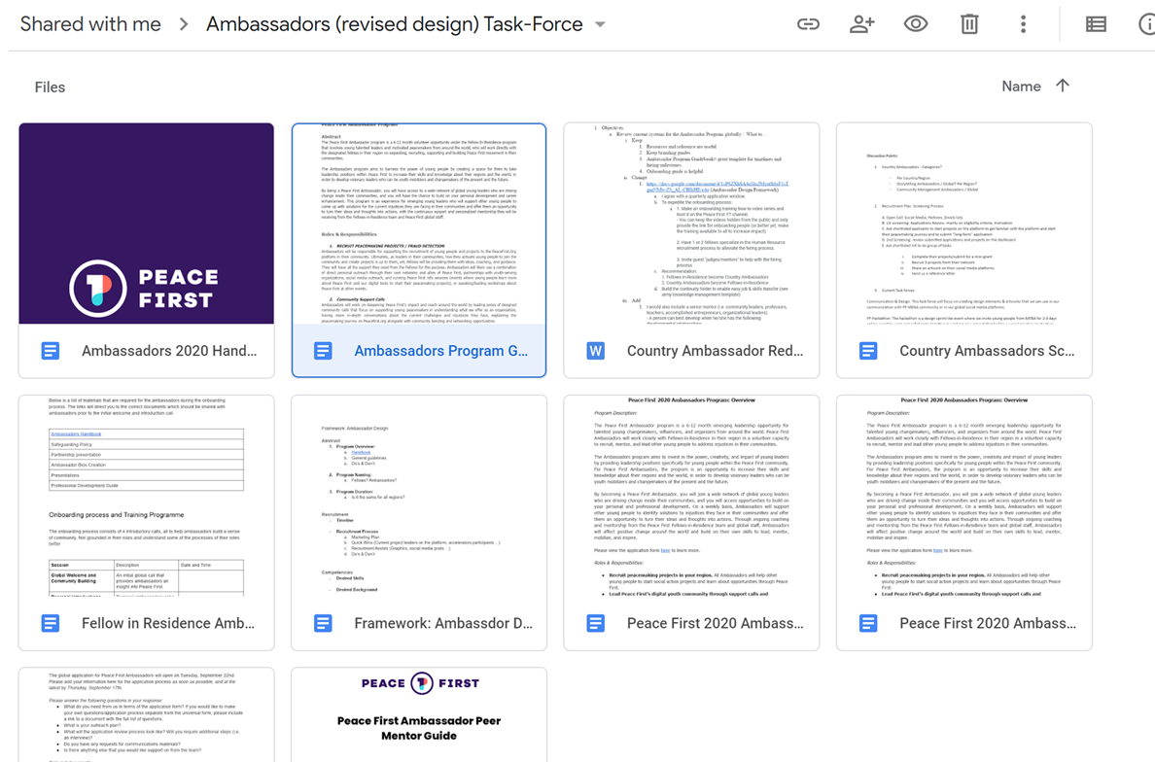
References:

Slide 4

What is a Decision Brief?
Organized method of presenting issues as decision points to foster group “buy-in” and participation.
  Useful for getting group or supervisor buy-in.
  Saves time by organizing issues and facilitating structured feedback.
Presents a specific issue.
Presents Courses of Action (COAs) for resolving the issue.
  Up to 3 COAs demonstrates a clear understanding of the issue and possible solutions.
  Relevant Evaluation Criteria is displayed to highlight major points of concern.
  LOW-MEDIUM-HIGH assessment ranges.
End state= Issues understood, resolved, and COAs agreed upon.

Slide 5
Decision Point #1: Recruitment Frequency
Discussion
Course of Action (COA) #1: Annual Recruitment
Issue: Determine when and how often Country Ambassadors are recruited.
Discussion: The Human Resources (HR) workload for recruiting and onboarding new C.A.s is too intensive.
Recommendation: Automate recruitment by holding quarterly hiring conferences led by 2 C.A.s (trained in an HR role) and supervised by 1 FIR. Create onboarding training videos for increased flexibility and training capacity.
Criteria | Pros | Cons
Workload | Low- 1x hiring conference/year Can onboard with FIR cohort | HR knowledge will be limited due to no ongoing training which may cause additional work.
Personnel Required | 1x Team of 4 (longer training period)
Impact |  | Low: Can only train 1 cohort per year.
Course of Action #2: Semi-Annually
Course of Action #3: Quarterly
Criteria | Pros | Cons
Workload |  | Medium- 2x hiring conferences per year
Personnel Required |  | 1x Team of 4 (twice a year)
Impact | Medium: Train 2 cohort per year.
Criteria | Pros | Cons
Workload | HR Knowledge= High= Faster recruitment timeline | Can be high workload if systems are not automated
Personnel Required | Videos and Automation + Domain knowledge= less personnel required | 1x Team of 4 1x FIR Supervisor
Impact | HIGH: rolling recruitment enables more youth to be trained
Notes:
22JUL Brief→ Draw the attention to the yellow star and green font (= approved)
Intent: foster a discussion to secure buy in
Purpose 2 (P2): Identify and implement and recommended items from current Ambassadors

Slide 6
Decision Point #2: Management Structure
Discussion
Issue: Determine the ideal CA management structure that will not take away from FIR working capacity.
Discussion: CAs are meant to support FIRs and increase the Peace First footprint. A management structure that enables FIRs to assume a supervisory role over new and senior CAs can dramatically increase the Peace First organizational capacity.
Recommendation: FIRs create and manage a team of “Level 2- L2” (senior Country Ambassadors) to train and manage new (Level 1- L1) C.A.s to increase the organization’s overall impact.
Ideal Span of control=1 person should manage no more than 5 people MAX
See Next Slide for Org Chart
COA #1: No L2s
COA #2: L2s (Senior CA Positions)
Criteria | Pros | Cons
Workload | No additional training/onboarding requirements | HIGH FIR supervisory requirements for CAs
Cohort Size |  | Small= 10-20 FIRs manage all CA
Impact |  | Low: FIRs work capacity would be limited by managerial/training requirements.
Criteria | Pros | Cons
Workload | Well trained L2s can manage the L1 CAs → Frees up FIRs to management roles | Could result in increased FIR supervisory requirements for CAs if managed incorrectly.
Cohort Size | Large= 20 FIRs manage 20 L2s whom manage 80 CAs
Impact | L2s learn management skills More CAs can be recruited and trained More projects can be launched

Slide 7
Ambassador/Volunteer Model
Senior Program Manager
1x FIR
L2 C.A.
L2 C.A.
L2 C.A.
L2 C.A.
L1 C.A.
L1 C.A.
Peacemaker
Peacemaker
Peacemaker
Peacemaker
L1 C.A.
L1 C.A.
ORG CHART
Span of Control= 4
1 FIR= 4 L2s x 4 L1s x 4 Peacemakers = 64 people
Notes:
Permanent Staff ~$213k/YR (Estimates from “payscale.com”)
1x CEO/COO: ~$65-120K
1x Fundraising Specialist/Sales Director: $48-100k
1x Digital Marketing Specialist/Social Media Manager: ~$48k
1x Social Impact Consultant/Project manager/Training Specialist: ~$55-75k
Virtual Assistants: $2,400-4,800/YR (part-full time range if outsource internationally)

Slide 8
Decision Point #3: Country Ambassador (CA) Size
Discussion
Course of Action (COA) #1: No L2s
Issue: Determine the ideal CA cohort size.
Discussion: CAs are meant to support FIRs and increase the Peace First footprint. More CA can be a great thing if the work needed to manage them does not take away from FIR working capacity.
Recommendation: FIRs manage a team of “Level 2- L2” (senior Country Ambassadors) to train and manage new (Level 1- L1) C.A.s to increase the organization’s overall impact.
Ideal Span of control=1 person should manage no more than 5 people MAX
Criteria | Pros | Cons
Workload | No additional training requirements for L2 Program | HIGH FIR requirement to manage CAs
Cohort Size |  | LOW: 40 C.A.s supervised by 10 FIRs (team leaders)
Impact |  | Low due to reduced number of CA positions
COA #2: 10x L2s
Criteria | Pros | Cons
Workload | Well trained L2s can manage the L1 CAs → Frees up FIRs to management roles | Could result in increased FIR supervisory requirements for CAs
Cohort Size | Medium= 10 FIRs manage 10 L2s whom manage 40 CAs
Impact | L2s learn management skills More CAs can be recruited and trained More projects can be launched

Slide 9
Decision Point #4: CA Roles and Responsibilities
Discussion
Issue: Determine the CA roles and responsibilities.
Discussion: CAs are meant to support FIRs and increase the Peace First footprint. CAs should be enbabled with easy-medium FIR tasks and should be responsible for a capstone project of their own.
Recommendation: CAs conduct easy-medium FIR tasks within their country and launch 1x country wide capstone project.
Capstone Project Characteristics
Country Wide
Involve Home-Country Peacemakers
Ambassador Program Completion Requirement
Roles and Responsibilities
Faster Compassionate Insight Feedback
Coaching Opportunities
Manage Easy-Medium FIR tasks
Recruit 3x new Peacemakers
Manage at least 4 volunteers
COA #1: No Capstone Project
COA #2: Capstone Project
Criteria | Pros | Cons
Workload | FIR Project Support
Impact |  | Missed leadership professional development opportunity
Criteria | Pros | Cons
Workload | FIR Project Support | Increased FIR/CA work requirement
Impact | Huge leadership professional development opportunity. Capstone projects can be turned into side-hustles, place on resumes, and can be legacy projects.

Slide 10
Breakout Session- Seun
Share your name, age, and country.
What do you think the Ambassadors’ main role should be?
What should their priorities and outcomes be?
Notes:
For ‘Solution Tree’ option in ‘Talking to Others’ module.
Image description: The Peace First ‘Solution Tree’ worksheet.

Slide 11
Decision Point #5: Performance Reviews
Discussion
Performance Review Basic Structure:
Did you meet the expectations outlined in your duty description?
This is what you did well…
This is what needs improvement…
Do you have any feedback for me?
These are my expectations for the next quarter...
Counseling Frequencies:
Initial/Onboarding- describe duties and expectations
Bi-monthly check-ins
Quarterly Performance Reviews
End of Term Performance Evaluation
Issue: Determine the CA counseling/mentorship model.
Discussion: CAs need mentorship and guidance to develop into more effective peacemakers. A counseling/mentorship program would provide valuable real-time performance feedback while providing a routine safe space for mentorship.
Recommendation: Conduct quarterly performance reviews and bi-monthly check-ins.
Note: This decision depends on the management structure selected.
COA #1: Quarterly Counseling
COA #2: Monthly Counseling
Criteria | Pros | Cons
Workload | Minimal
Impact |  | No frequent check-ins can result in missed project targets or mentorship opportunities
Criteria | Pros | Cons
Workload |  | Increased FIR/CA work requirement
Impact | Frequent check-ins provide necessary guidance and intent. Valuable mentorship opportunity.
Notes:
Note: Dependent on management structure

Slide 12
Decision Point #6: Acknowledgments & Rewards
Discussion
Issue: Determine how to recognize CA contributions.
Discussion: CAs go above and beyond to make their communities and the world better. Their hard work should be recognized.
Recommendation: Conduct a close out ceremony. Provide certificates of completion. Write LinkedIn letters of recommendations that they can publish to the world. Send Peace First Merchandise (if able).
Acknowledgements
Rewards ceremony
Certificates of completion
Public LinkedIn Recommendations
Rewards
Short listed for FIR program
Peace First Merch
Speaking Opportunities
Partnership Opportunities
Networking Opportunities
Comprehensive Leadership and Professional Development (LPD) Program
How to Best Close-Out Current Cohort
Discussion

Slide 13
Breakout Session- Tahmid
Share your name, age, and country.
What additional rewards should we provide?
Notes:
For ‘Solution Tree’ option in ‘Talking to Others’ module.
Image description: The Peace First ‘Solution Tree’ worksheet.

Slide 14
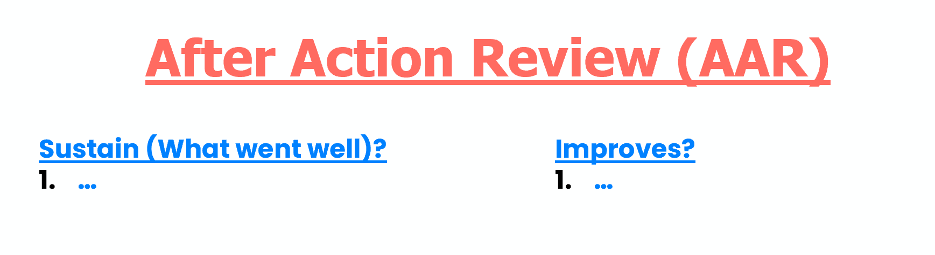
Decision Point #7: Knowledge Management
Discussion
Issue: Determine how to capture and store lessons learned to facilitate easy job transitions and skill transfers.
Discussion: Lessons Learned are vital for continuous improvement and program/organizational growth.
Recommendation: Conduct event based or periodic “After Action Reviews-AARs” (i.e. lessons learned reflections). Place captured lessons into a continuity folder (Google Drive) that everyone can access and contribute to.
COA #1: Event Based AARs
COA #2: Monthly/Quarterly AARs
Criteria | Pros | Cons
Workload | Enables immediate targeted feedback. Should be conducted immediately after an event.
Impact | Continuous Improvement
Criteria | Pros | Cons
Workload | Can save time (10 mins) per meeting.
Impact |  | Will likely forget most lessons learned if not captured immediately.

Slide 15
Breakout Session- Seun/Tahmid
Share your name, age, and country.
What, if anything, is missing?
Notes:
For ‘Solution Tree’ option in ‘Talking to Others’ module.
Image description: The Peace First ‘Solution Tree’ worksheet.

Slide 16
Timeline Review
Onboarding and Next Steps

Slide 17
Recruitment Timeline
22 SEP 21
10 OCT 21
30 OCT 21
Applications open
Applications Close
Acceptance Notifications Sent
04 NOV 21
Program Start Date
04 DEC 21
Monthly Counseling
*Based on 2020 Program Dates

Slide 18
Questions?

